Slide 1


Slide 2
Response from the Asian Dehonian Theological Commission (CTDAS)
To the CTDAL Paper on Dehon's Social Catechism (CSC)
Dehonian Theological Seminar

Slide 3
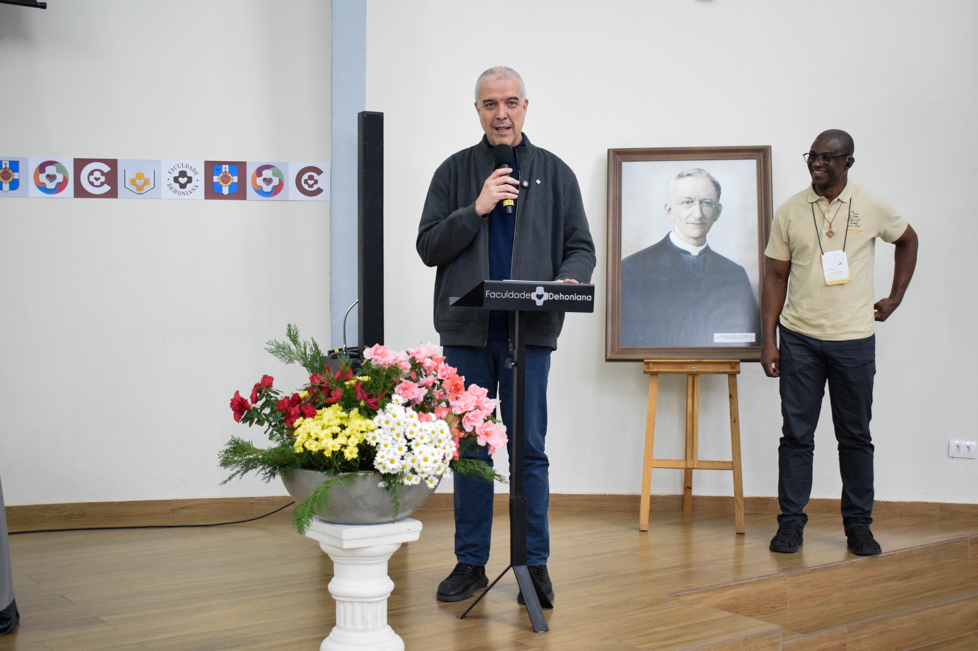

Slide 4
INTRODUCTION & GRATITUDE
Deep gratitude to CTDAL for their outstanding study
Their work is a significant contribution to understanding Fr. Dehon
They employed Wayne Booth’s literary theory (implied author & mock reader)
They revealed the pastoral heart and rhetorical genius of Fr. Dehon
Their analysis shows the Social Catechism is a living resource, not just a historical document

Slide 5
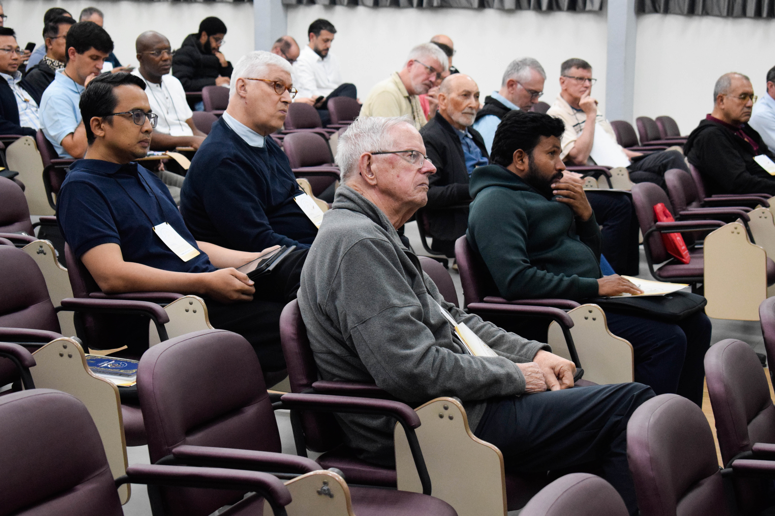
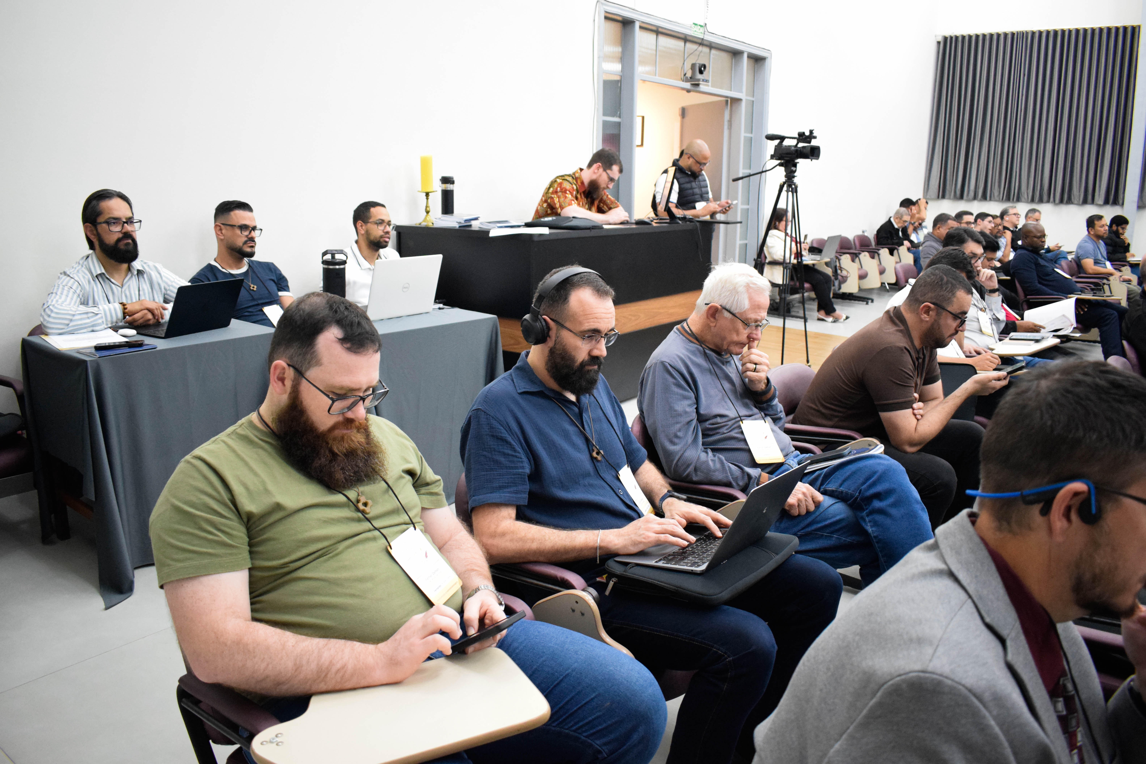

Slide 6
STRUCTURE OF CTDAS RESPONSE
The CTDAS response is organized in three sections:
Section 1: Overall analysis of CTDAL paper
Key contributions and strengths identified
Section 2: Portrait of Fr. Dehon as the implied author
Five key traits highlighted
Section 3: Five critical observations
Not criticisms, but invitations for deeper dialogue

Slide 7
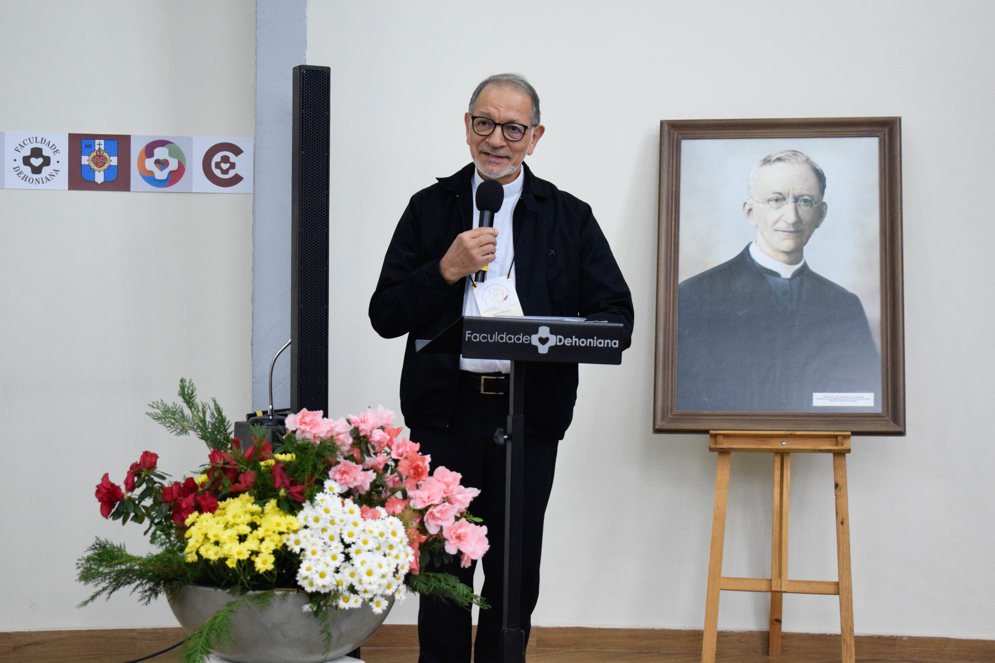
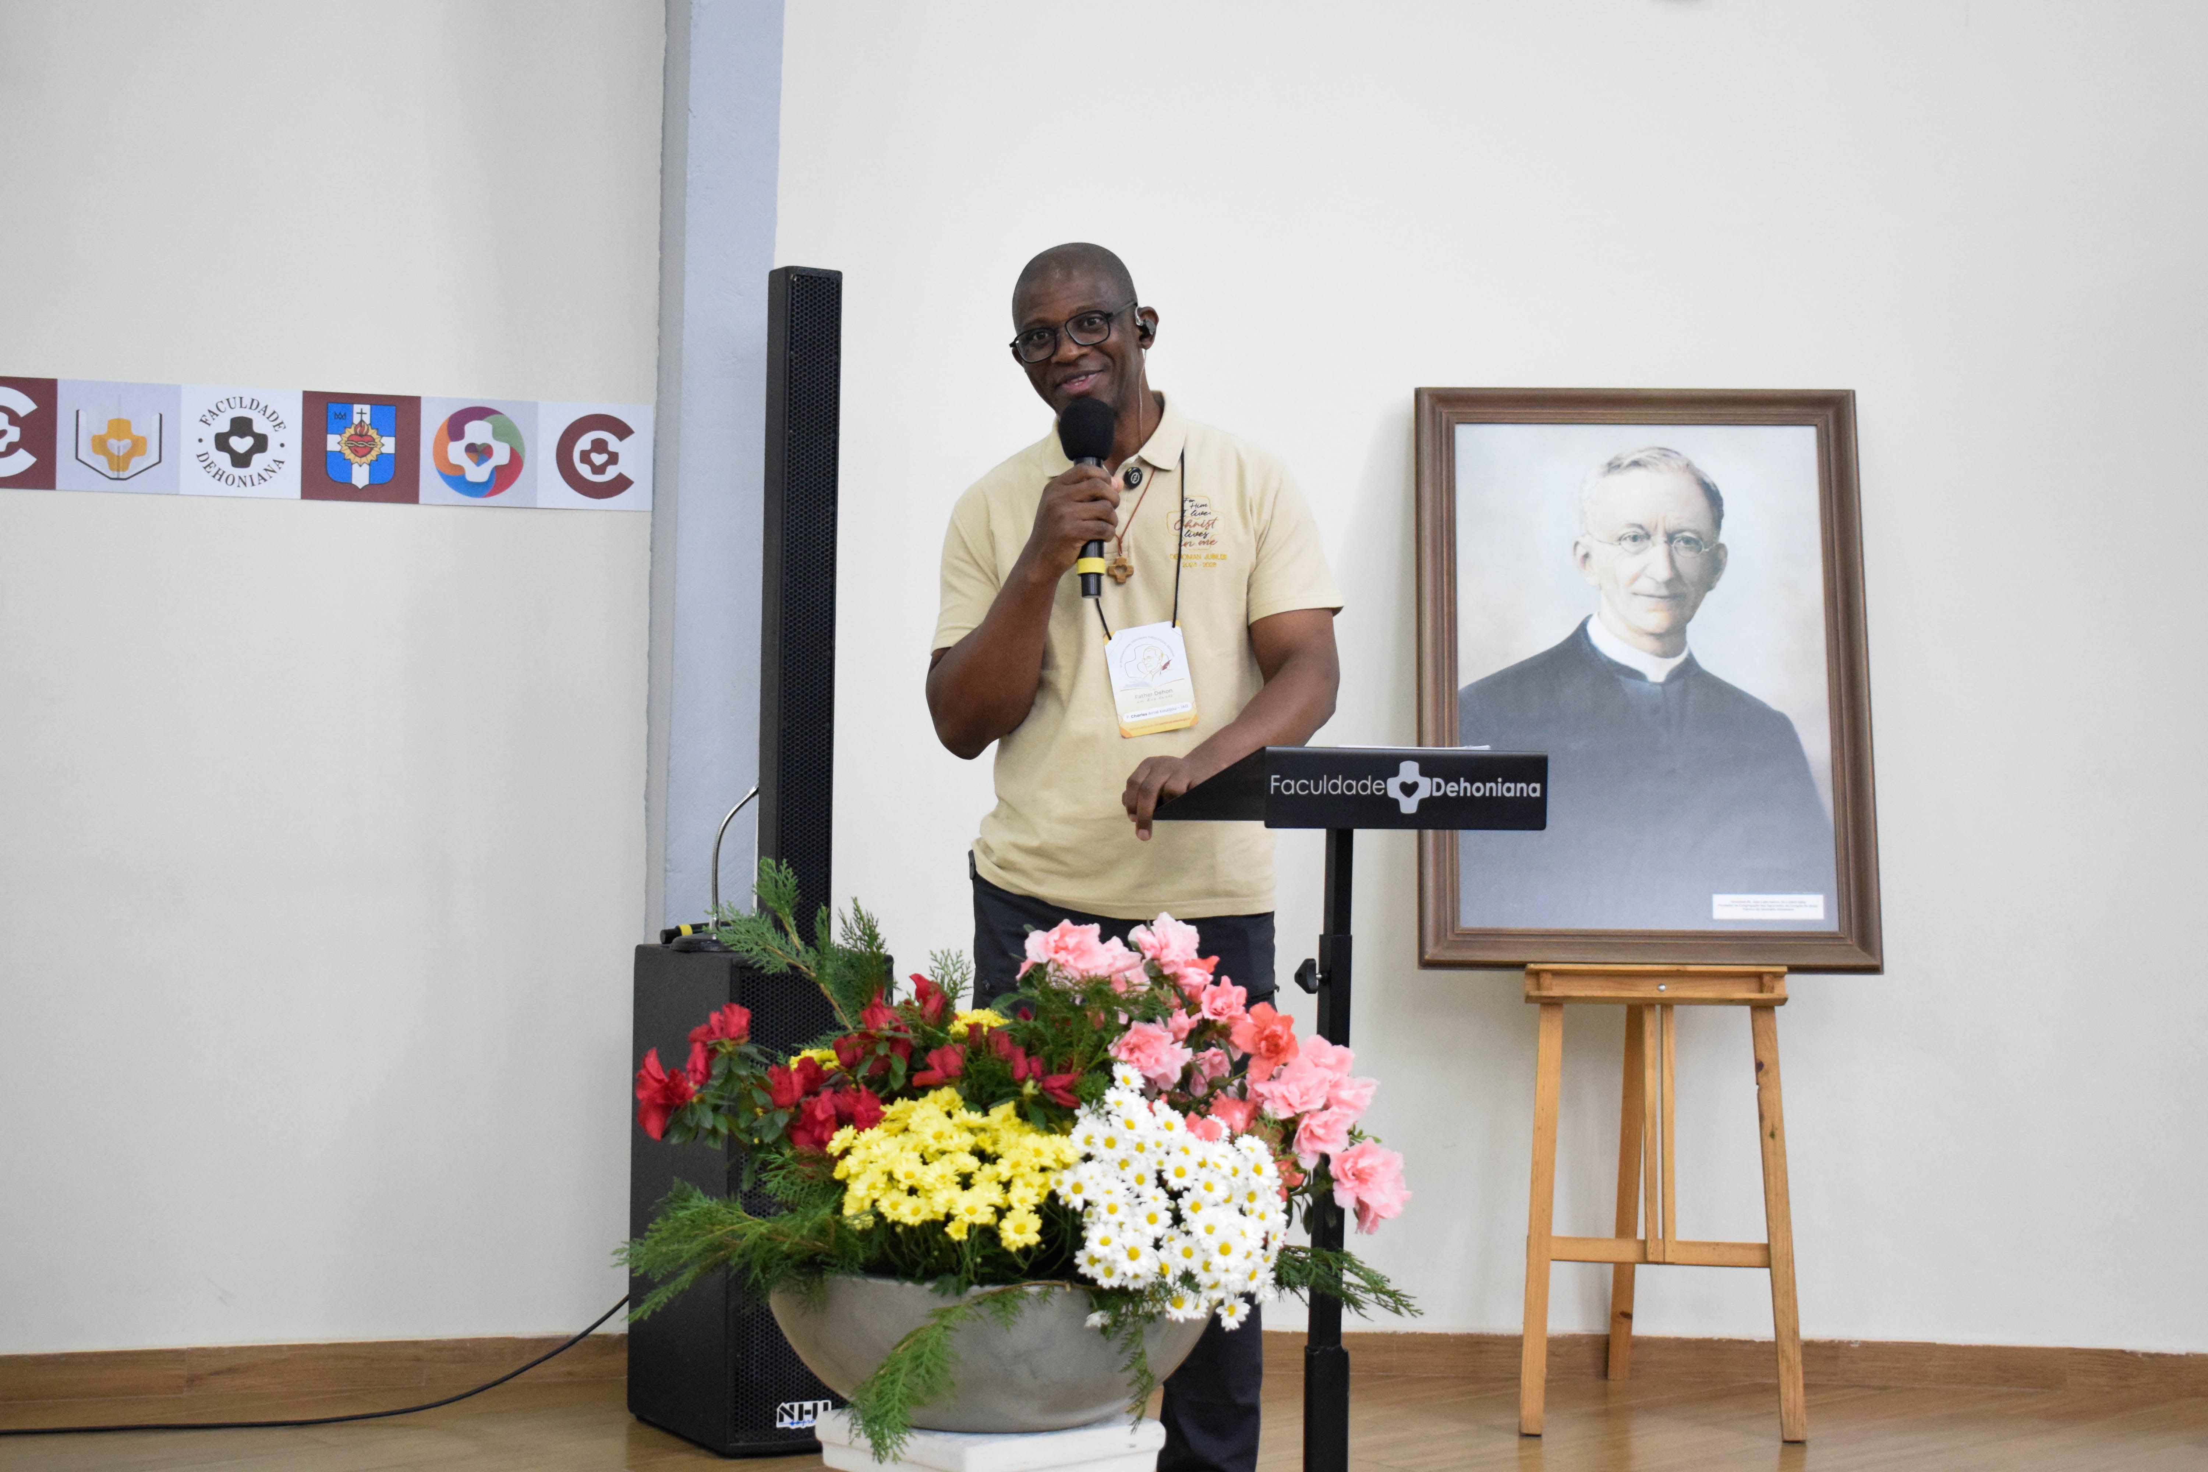

Slide 8
KEY STRENGTHS
1. Bridge Between Literary Theory and Theology
Applied secular framework to theological text without distortion
2. Deep Reading of Dehon’s Pastoral Heart
Revealed his genuine compassion for workers and poor
3. Clear Articulation of Dehon’s Relevance
Principles speak powerfully to contemporary challenges
4. Critical Engagement with Limitations
Honestly acknowledged Dehon’s historical and hierarchical limitations

Slide 9
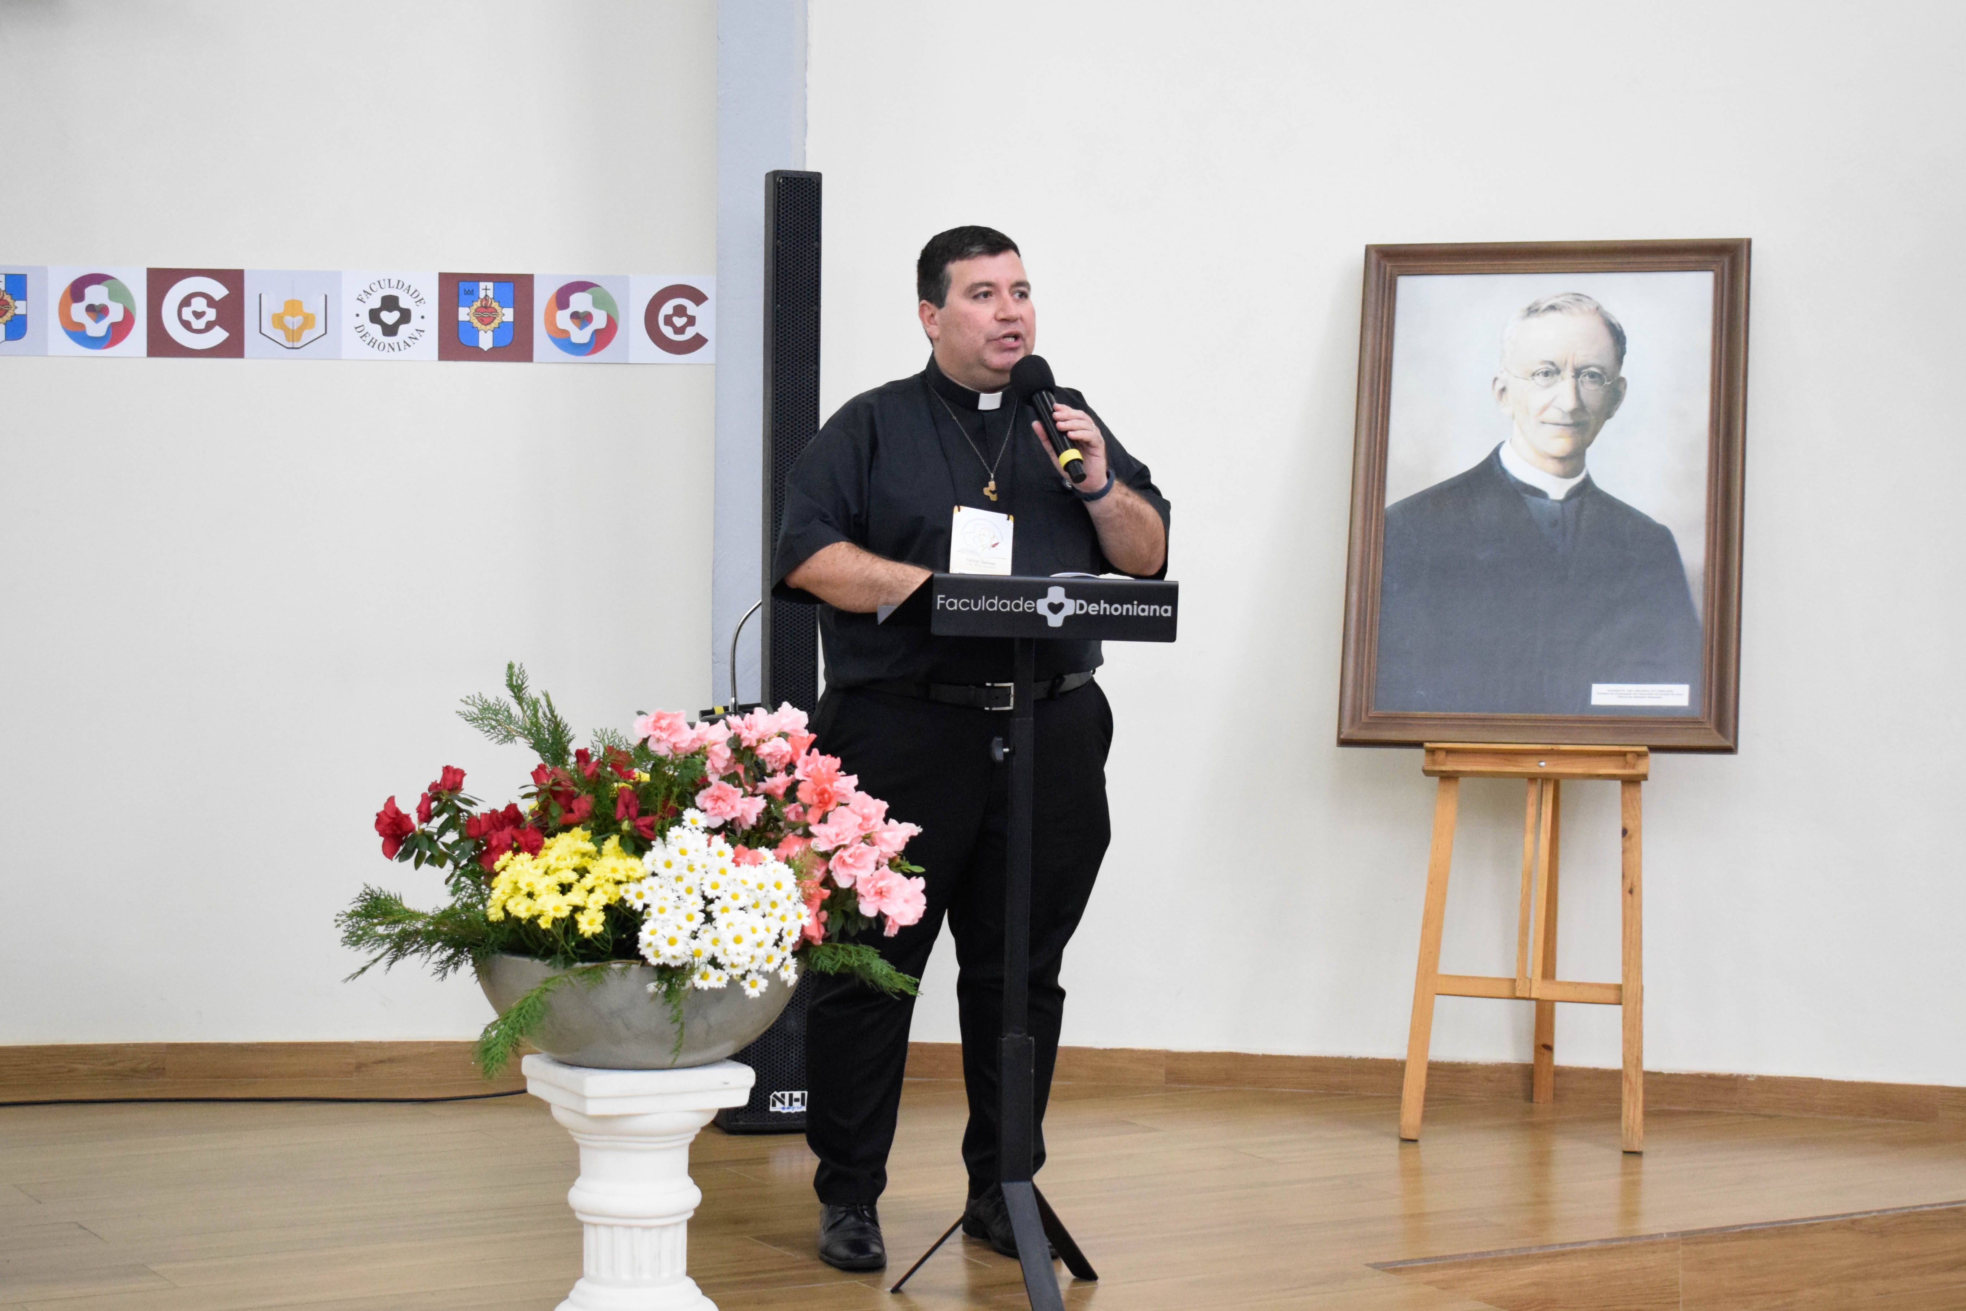
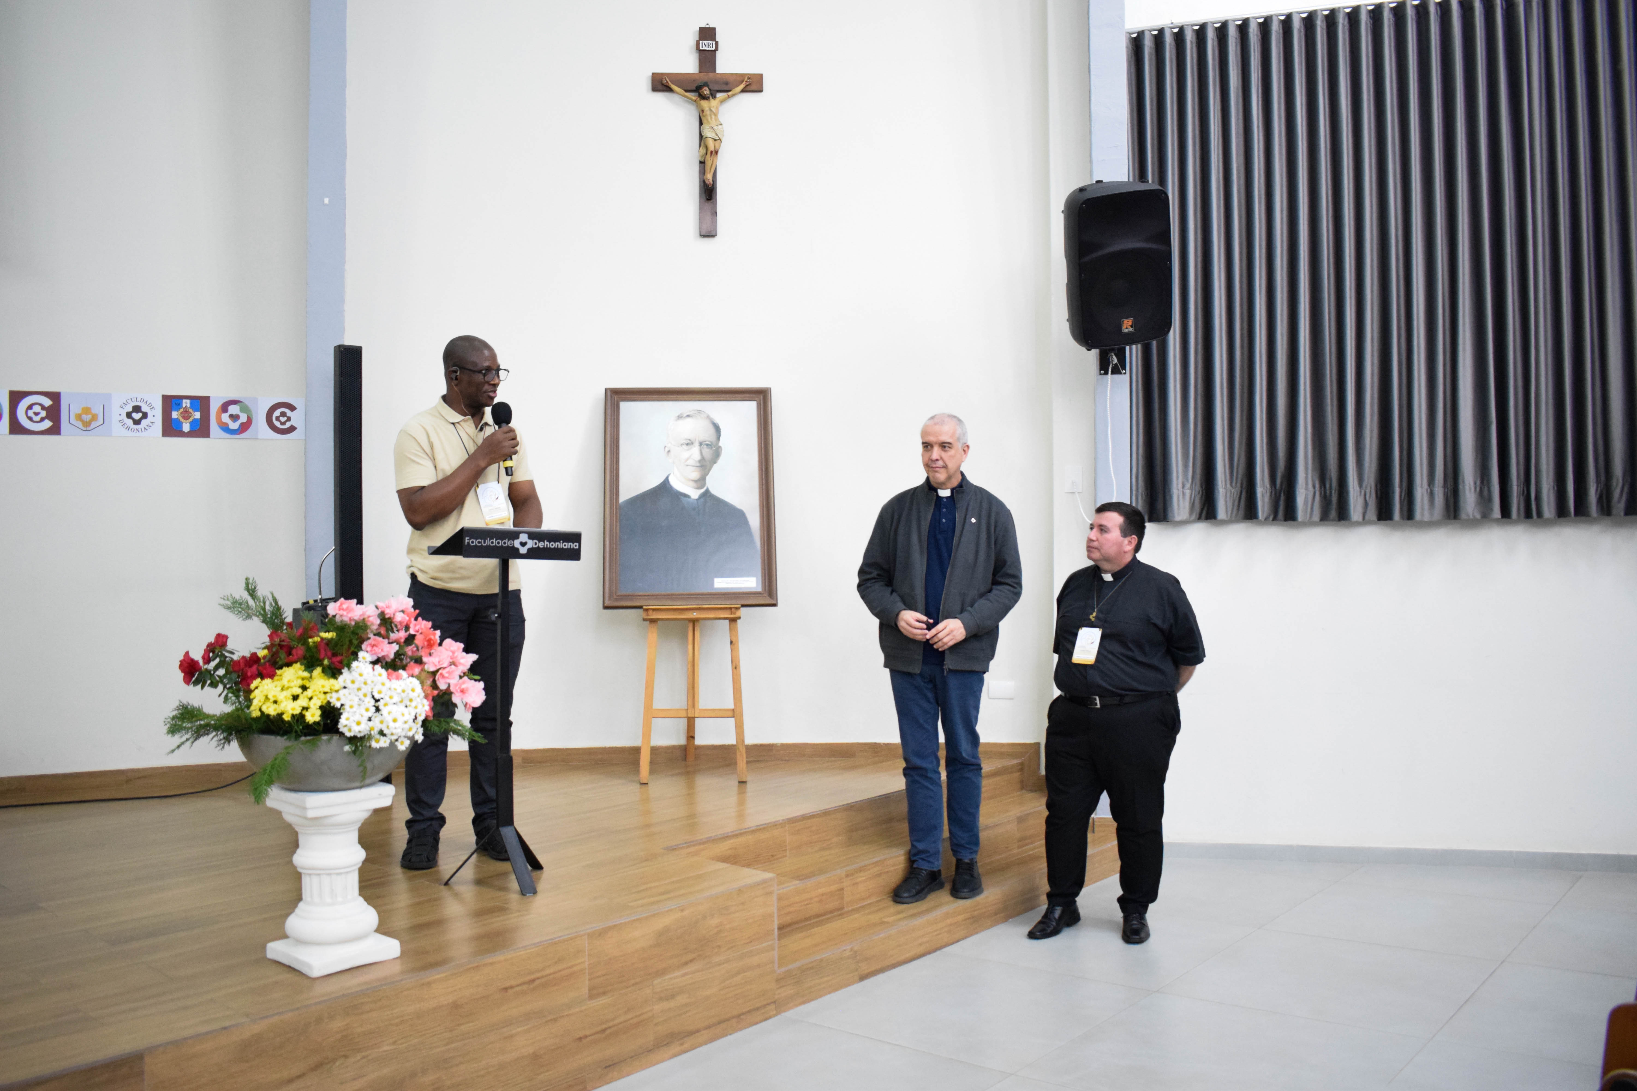

Slide 10
Key Themes from Dehon’s CSC
Seven significant themes emerge:
a. Church as Social Educator
b. Human Dignity as Foundational
c. Family as the First Society
d. Subsidiarity as Guiding Principle
e. Prophetic Mission of the Church
f. Integration of Spirituality and Justice
g. Church's Role in Public Life

Slide 11
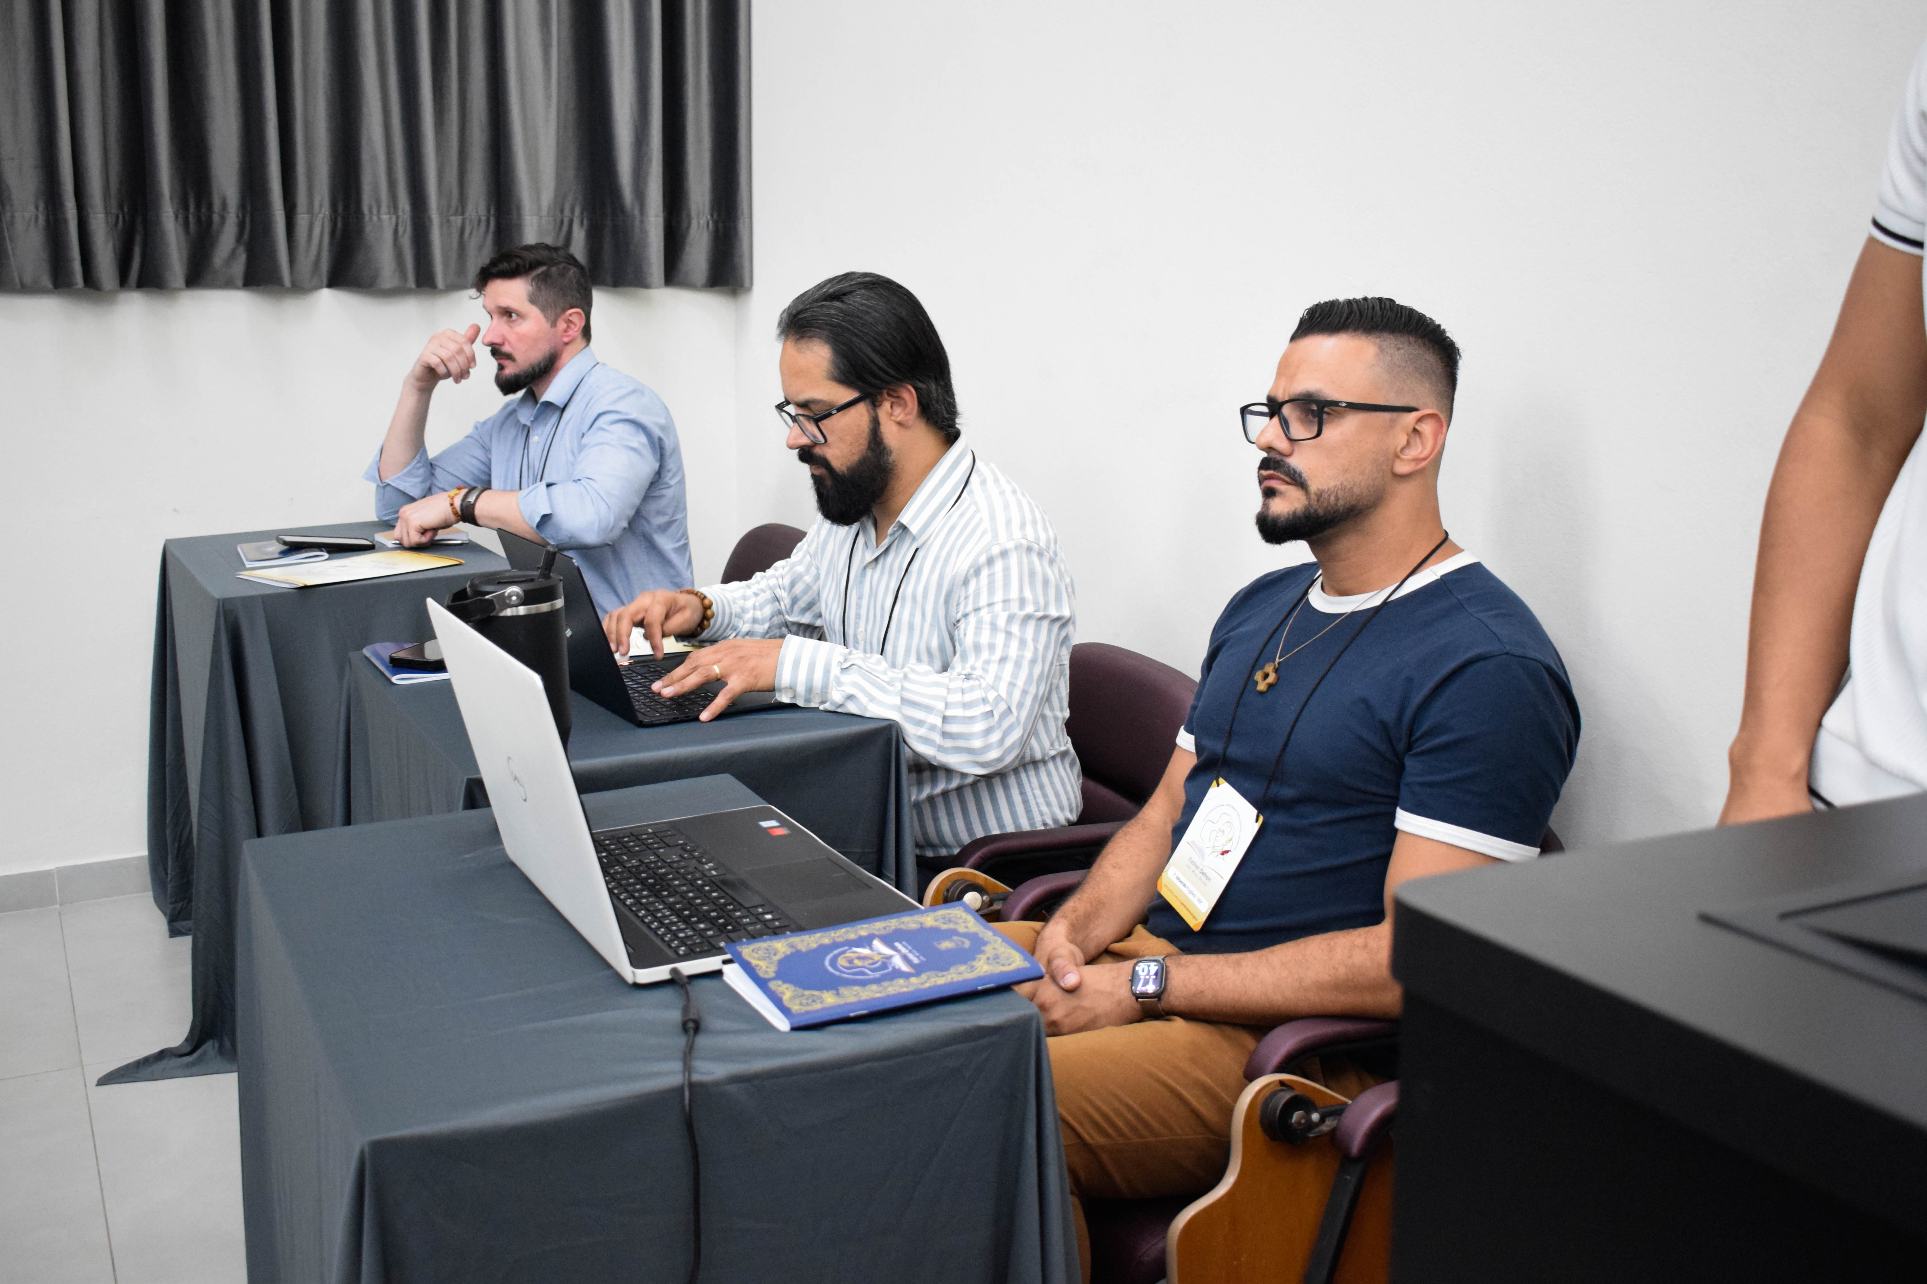
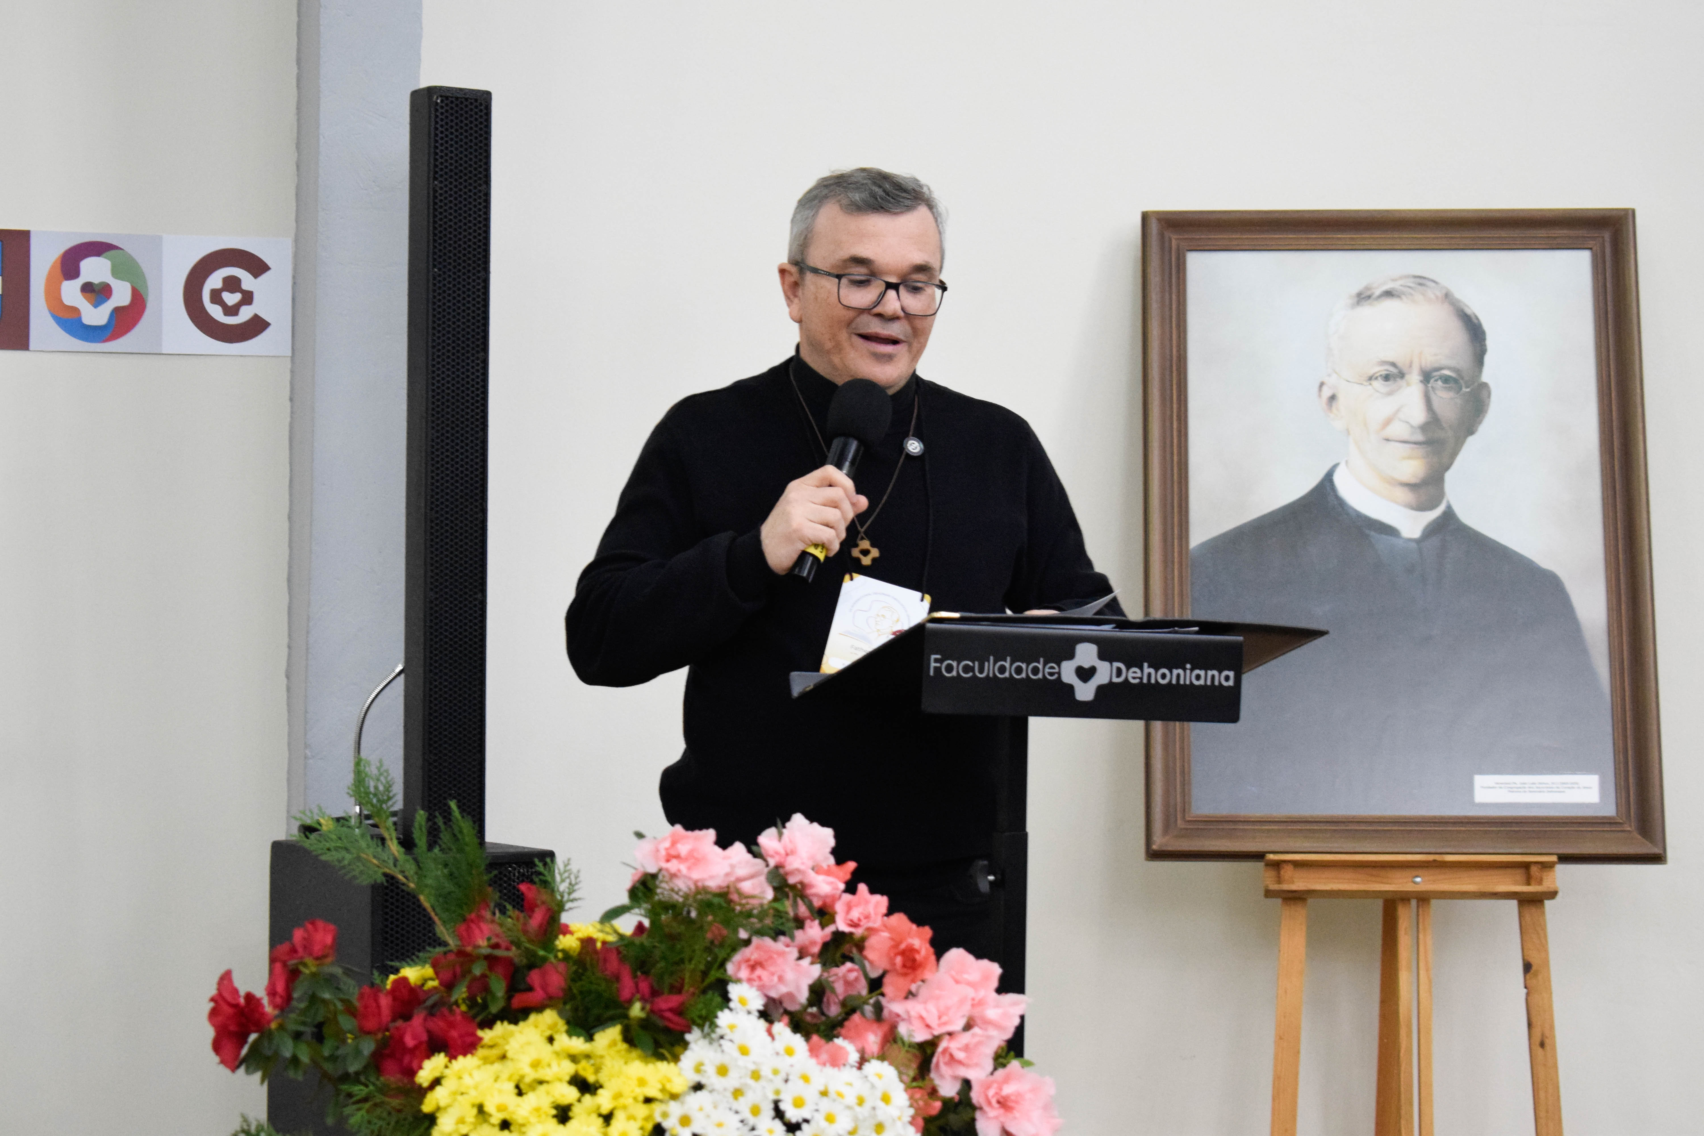

Slide 12
PORTRAIT OF DEHON AS IMPLIED AUTHOR
1. Dehon as Popular Translator & Social Educator: Made Leo XIII's teachings accessible to ordinary Catholics
2. Dehon as Rigorous Intellectual: Insisted on serious study as prerequisite for social apostolate
3. Dehon as Compassionate Authority: Balanced firm teaching with pastoral tenderness
4. Dehon as Defender of Church's Role: Fearlessly defended Church's right to speak on social matters
5. Dehon as Realistic Pastor: Distinguished between ideal and possible; adapted to circumstances

Slide 13
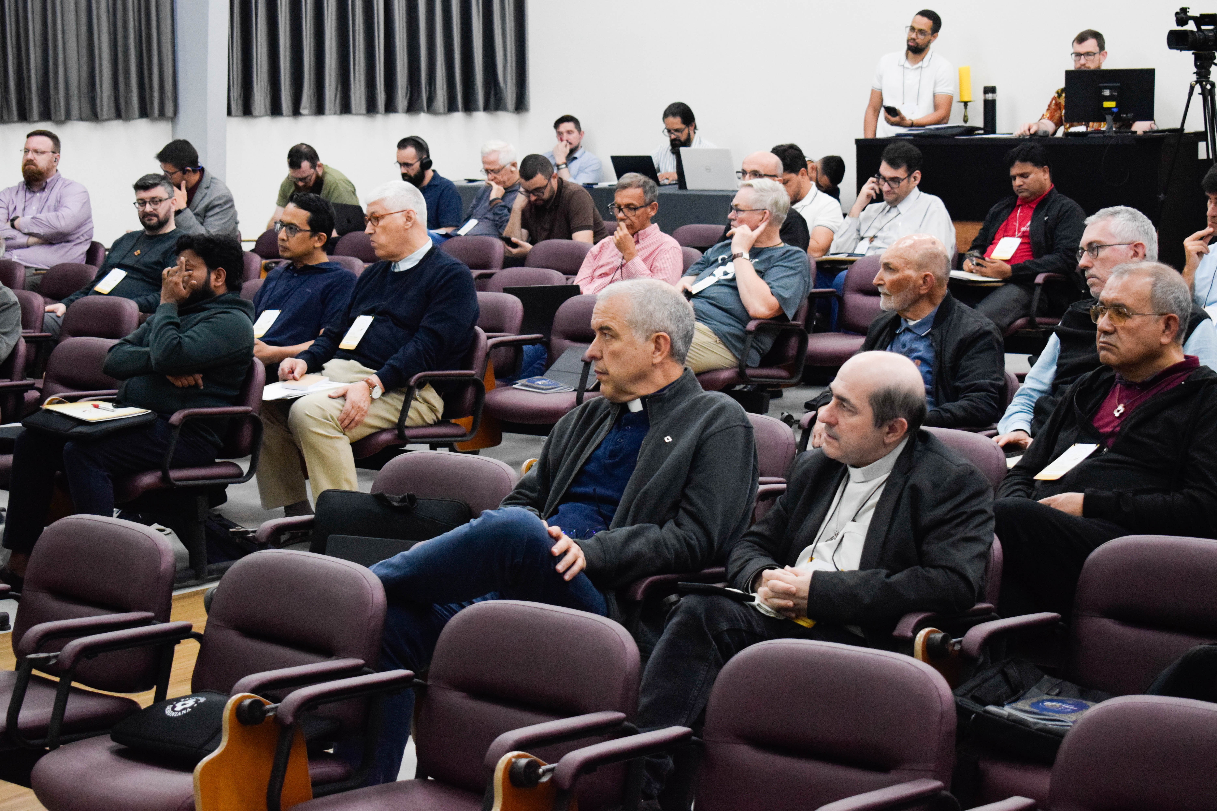

Slide 14
DEHON’S THREE-FOLD ARGUMENTATION
How Dehon Persuades His Readers:
Moral Reason: Appeals to natural justice and human dignity
Ecclesiastical Doctrine: Grounds everything in papal magisterium
Concrete Social Experience: Describes real problems to create urgency
This threefold approach gives the text persuasive depth beyond mere moralism

Slide 15
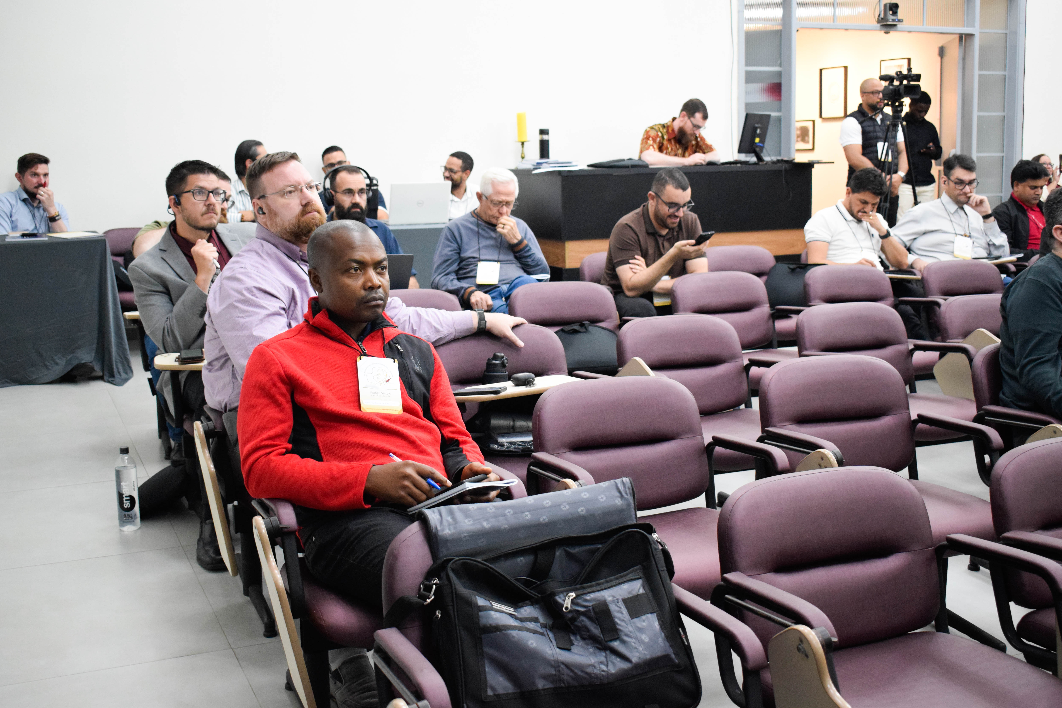

Slide 16
OBSERVATION 1 - THE DANCE AND THE DANCER
Key Question: Can Dehon's way of operating inspire us today, beyond his specific ideas?
CTDAL focuses more on principles than on Dehon's style, methods, approach
In Asia, we face different challenges: religious pluralism, poverty, caste discrimination
Dehon's persona as translator, bridge-builder, pastor engaging big issues
His methods may be even more valuable than his specific ideas

Slide 17
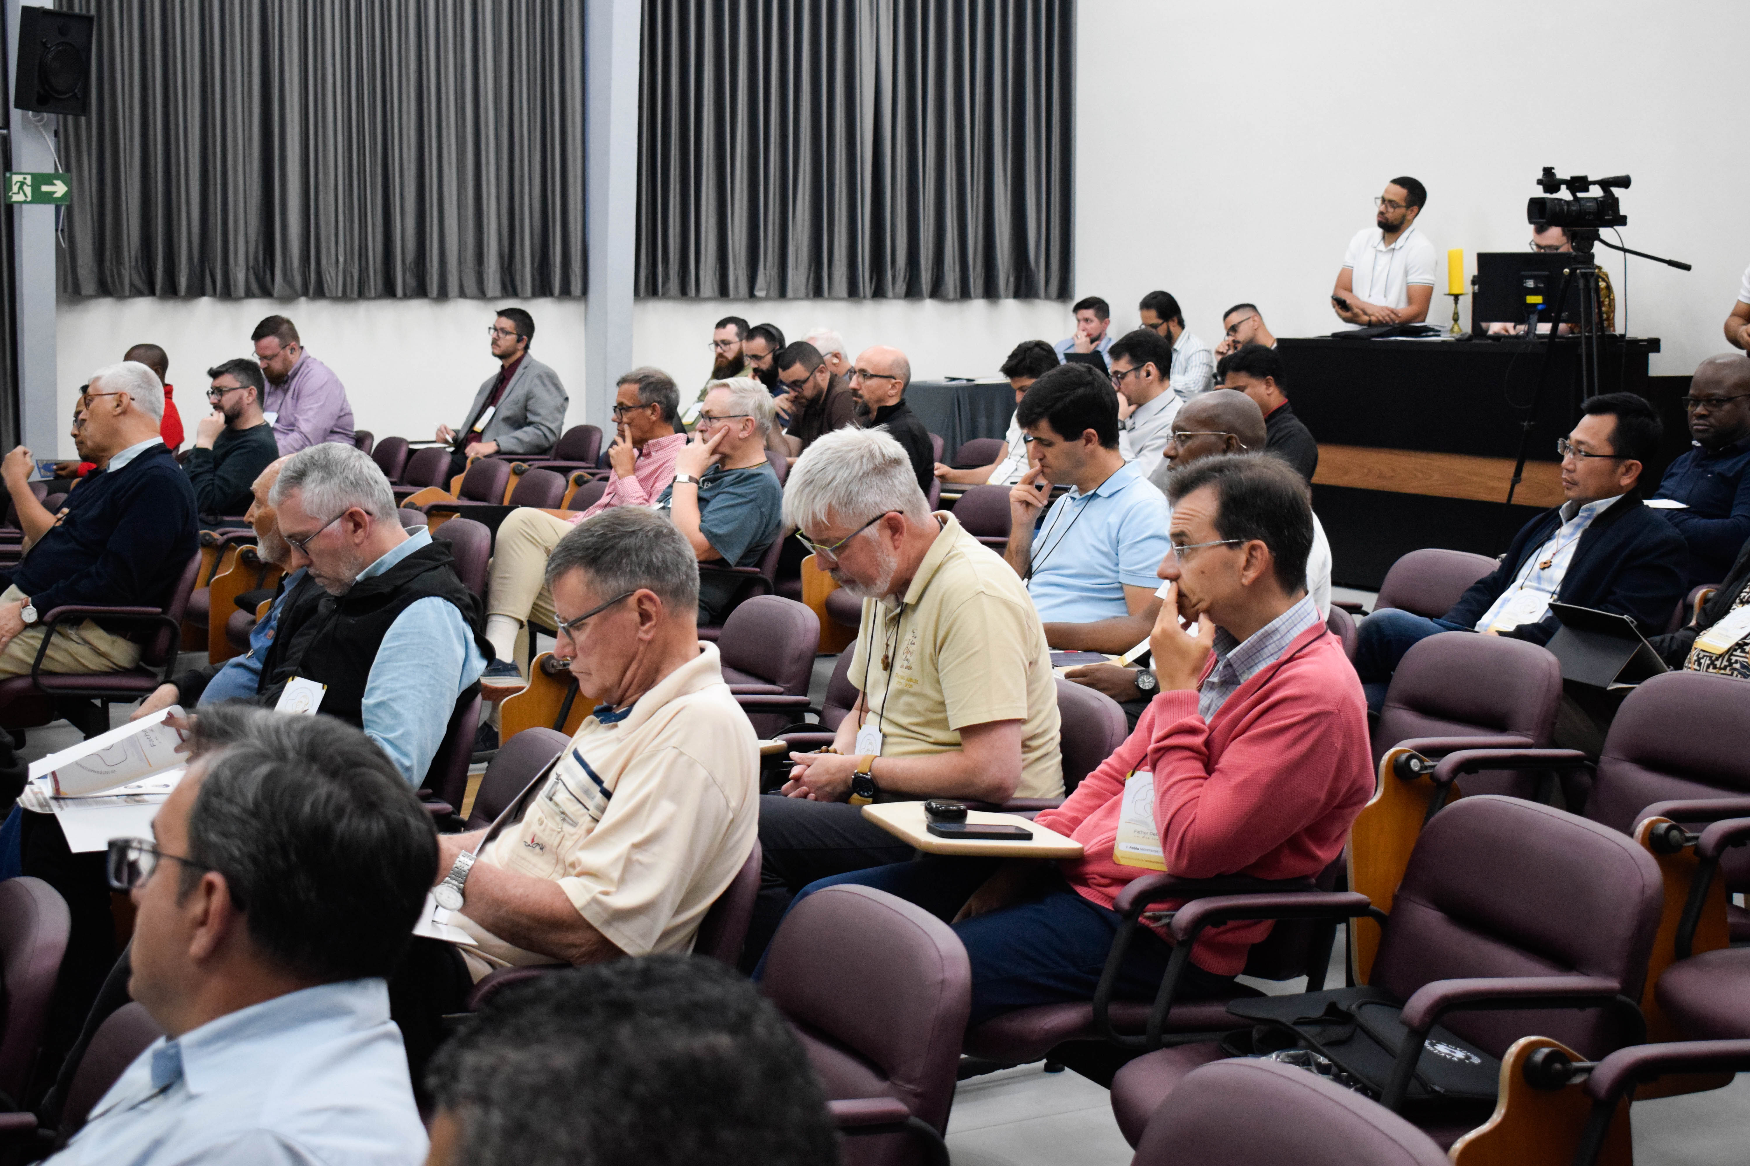

Slide 18
OBSERVATION 2 - TOOL FOR NOVELS, USED ON A CATECHISM
Key Question: Can a tool meant for fiction work well for a catechism?
Booth’s theory designed for novels (fiction)
Catechism is different - transmits Church's teaching
Dehon's voice is subordinated to papal authority
Need nuanced approach that respects catechism genre and Still find pastoral heart within it
Acknowledge text shaped by communal and magisterial traditions

Slide 19
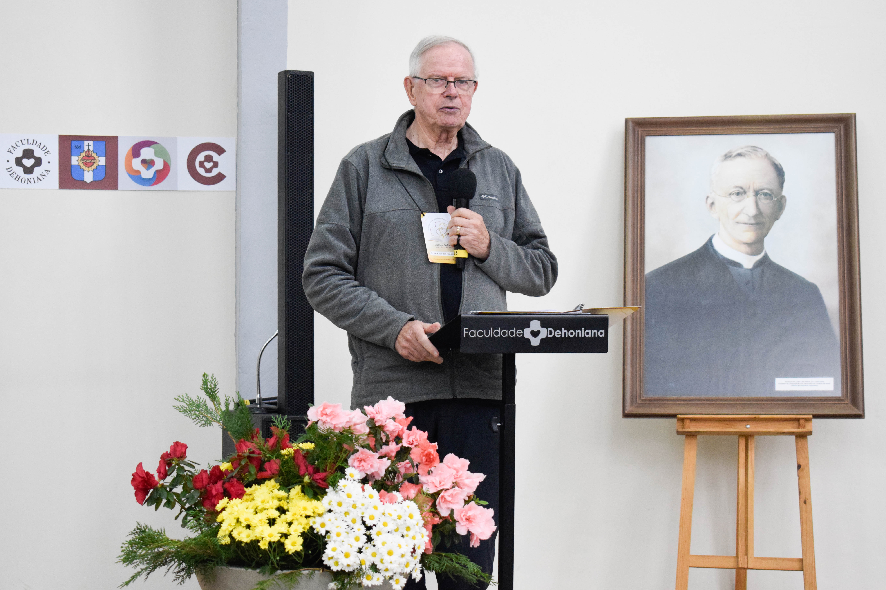


Slide 20
OBSERVATION 3 - REAL READER VS. IMAGINED READER
Key Question: How do we distinguish between historical audience and textual construct?
“Mock reader” is a textual construct (imagined reader). “Target audience” is real historical people
The paper sometimes mixes these two
Understanding this distinction helps us see rhetorical strategies
Was Dehon writing for a specific group or creating an ideal reader?

Slide 22
OBSERVATION 4 - COMPASSIONATE HEART, HIERARCHICAL MIND
Key Question: How do we honor Dehon's compassion while critiquing his limitations?
Dehon had genuine compassion for workers and poor
But his mind was shaped by hierarchical worldview
Did not question deeper structures of capitalism
In Asia, issues of caste, class, colonial legacy are deeply felt
Cannot reproduce Dehon’s vision without critical reflection; Discern what is enduring and what is historically conditioned

Slide 23
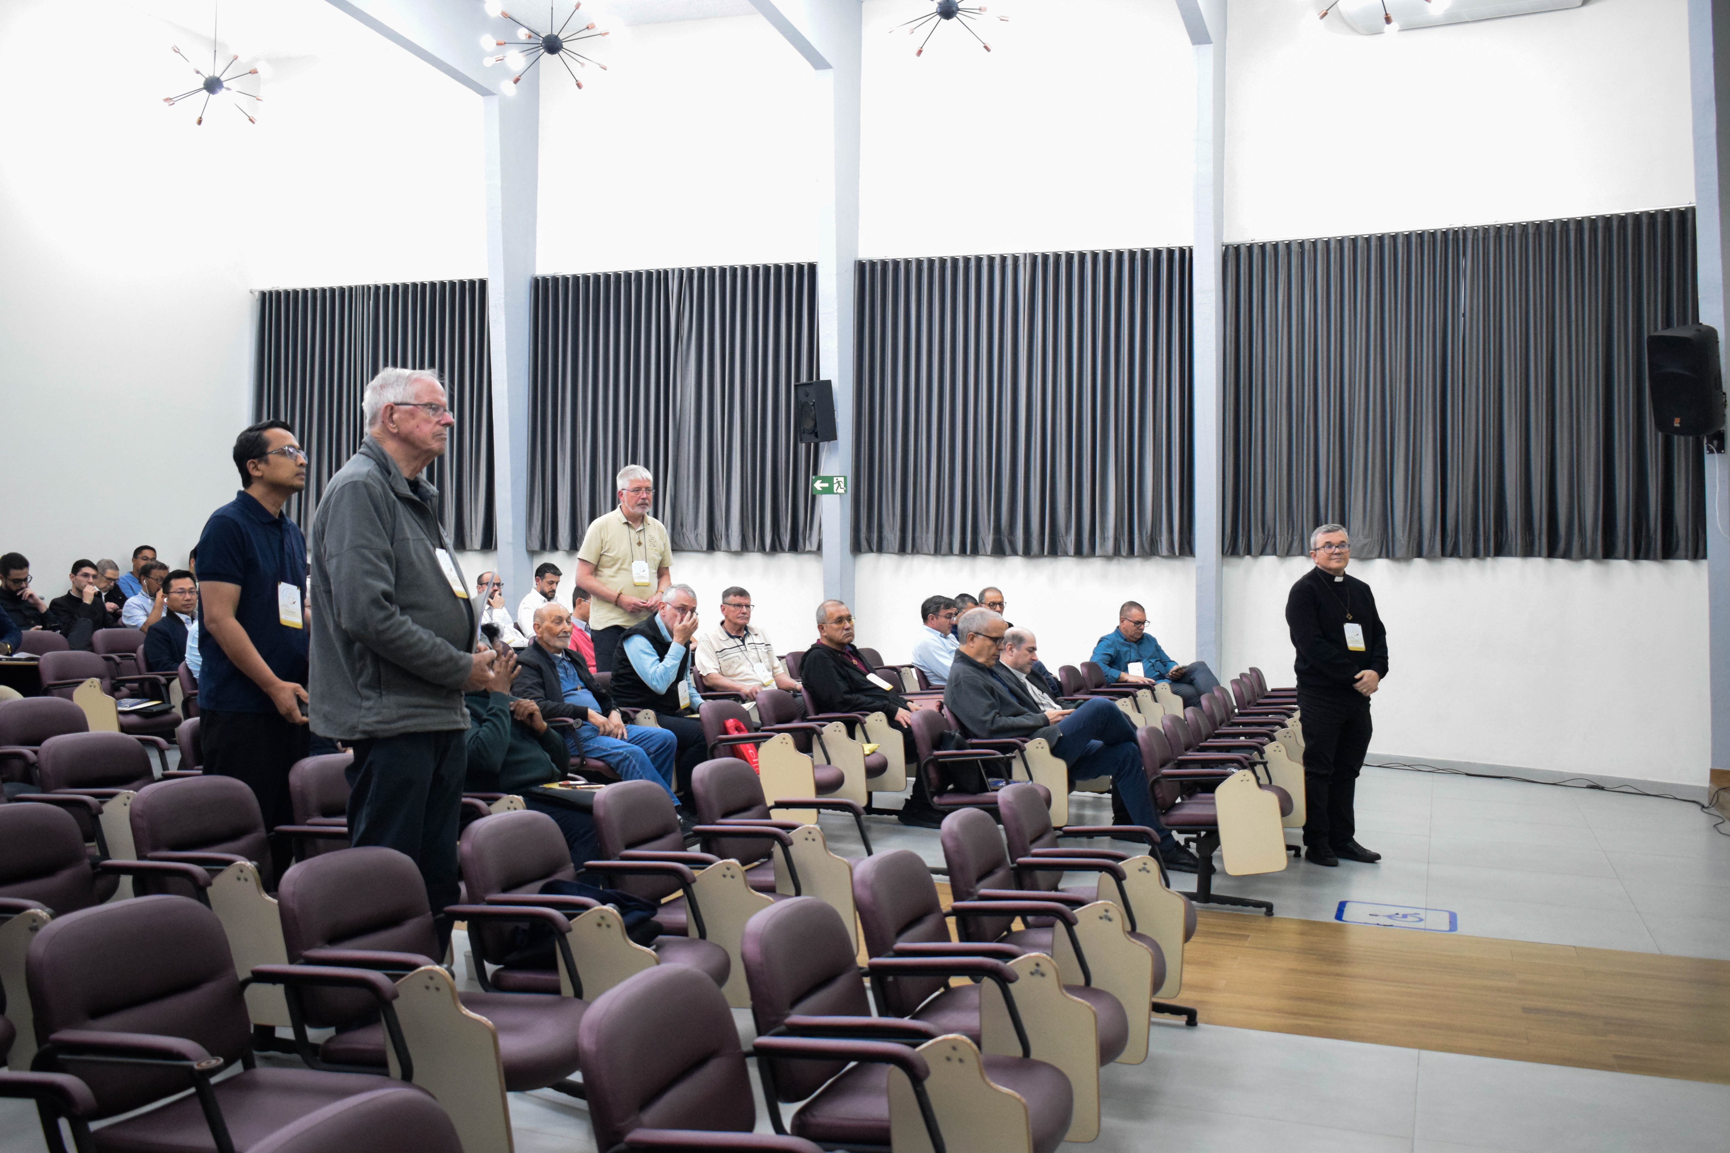

Slide 24
OBSERVATION 5 - PRAYER AND ACTION, LAITY AND DIALOGUE
Key Questions:How do we integrate spirituality and justice? How do we form laypeople as active participants? How do we learn from one another across contexts?
Integration often missing today - spirituality and action seen as separate. Laity often seen as passive recipients
Dehon’s example challenges false separation
His vision of laity as “social educators” is prophetic but not fully Realized
This international seminar is precious opportunity for dialogue

Slide 25
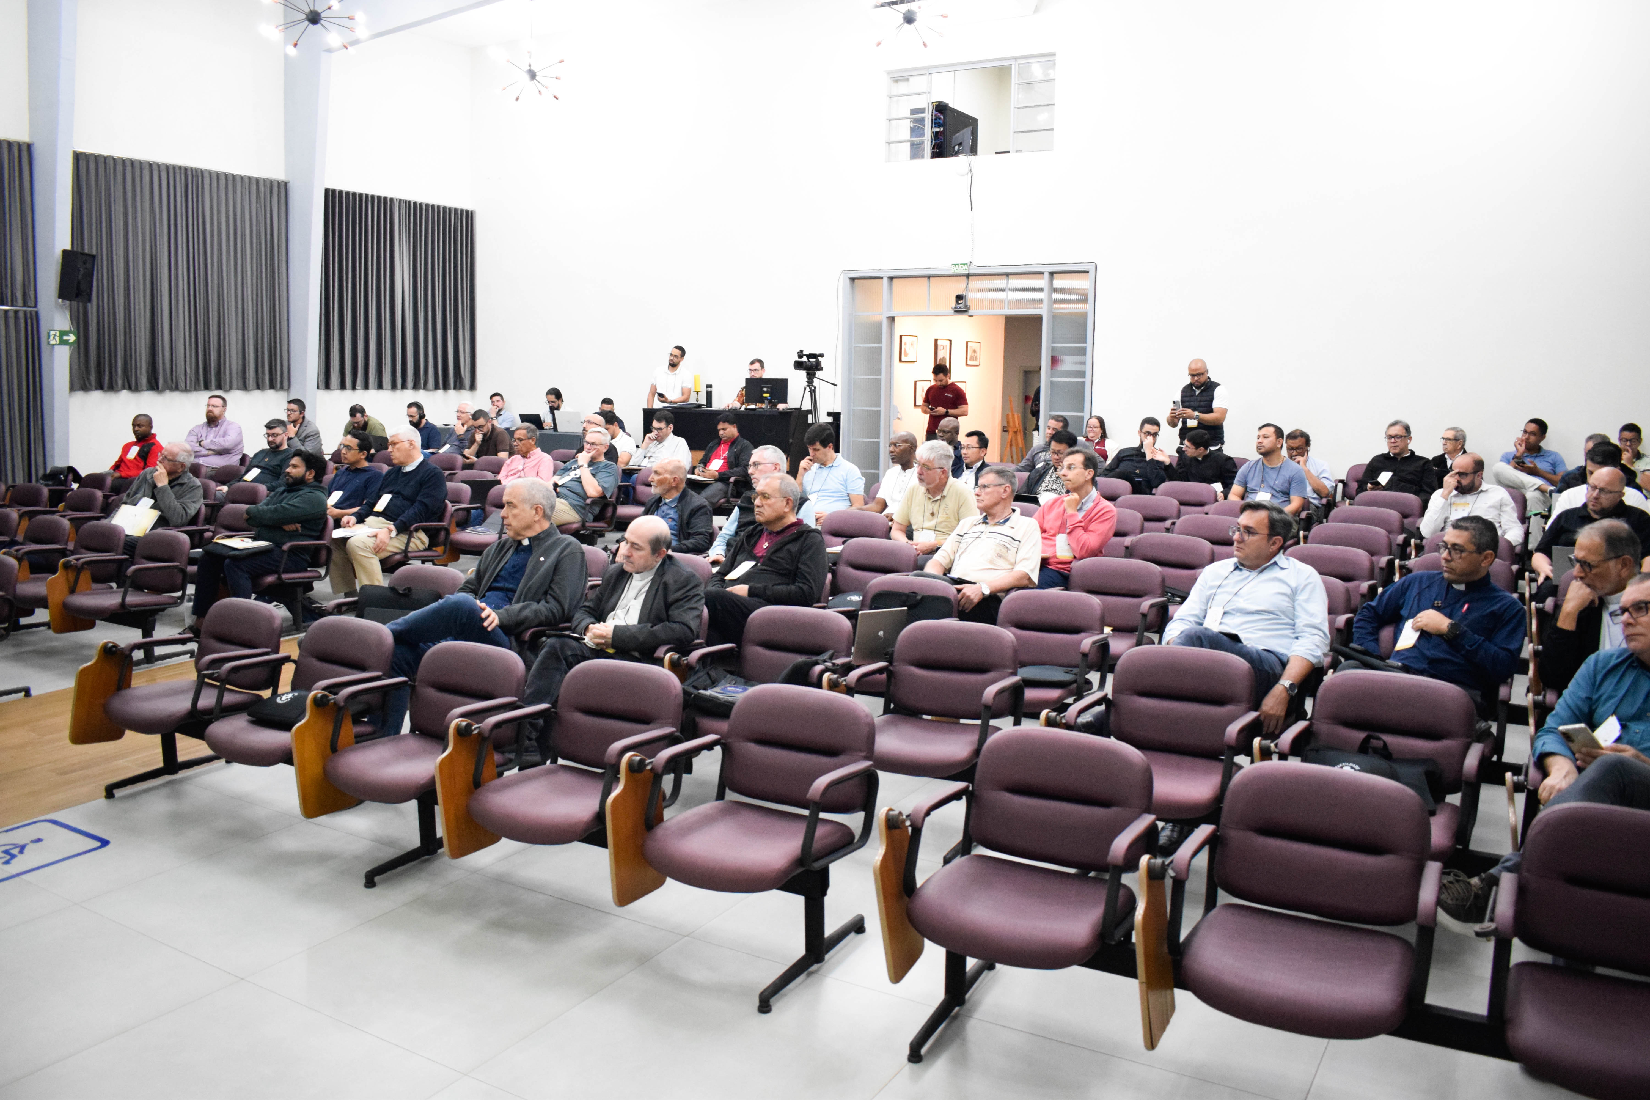

Slide 26
FIVE KEY QUESTIONS FOR FURTHER DISCUSSION
The Dance and the Dancer: Can Dehon's way of operating inspire us today?
Tool for Novels, Used on a Catechism: How do we respect catechism genre while finding pastoral heart?
Real Reader vs. Imagined Reader: How do we distinguish between real and imagined readers?
Compassionate Heart, Hierarchical Mind: How do we honor compassion while critiquing limitations?
Prayer and Action, Laity and Dialogue: How do we integrate spirituality and justice across contexts?

Slide 28
CTDAS Final Words:
Deep appreciation for CTDAL's work
It is a gift to the Congregation
Reveals pastoral heart, intellectual rigor, spiritual depth of our Founder
Demonstrates enduring relevance of his social thought
The five observations are invitations for deeper reflection and dialogue
May the Heart of Jesus continue to inspire us in study, prayer, and commitment to building a more just and compassionate world in the person of Fr. Dehon and his Texts

